Slide 1

Phosphorus variation in the Colorado River Watershed
Naila Costa, Dietrich Epp Schmidt, Erin Larson, Stephanie Shousha
Data-driven ecological synthesis summer school
Station de Biologie des Laurentides, Université de Montréal May 7, 2017

Slide 2

DDESSS Project
Phosphorus in the Colorado River Watershed
How does TP, TDP variability vary with stream size?
How does TP, TDP concentration vary with differing land use?
Predictions
Increased homogeneity in P variability with increasing stream size
Increasing P quantity with increased anthropogenic effect

Slide 3
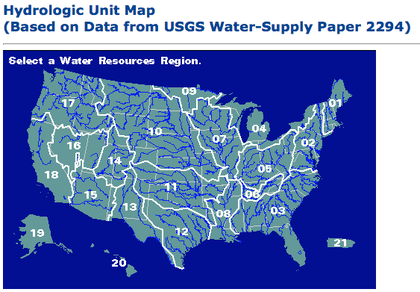
Colorado River Watershed
United States watersheds divided by HUC categories
Up to 8 numbers per division
Colorado River Watershed: HUC2 = 15
HUC4 = 1501 HUC8 = 14050006 (Corral Gulch Near Rangely, CO) Drainage area: 31.8 sqm

Slide 4
Data Management
OpenRefine
Cleaned the two data sets (Phosphorus & Land Use Tables)
R via Jupyter
Average of LandUse at the HUC8 scale
SQL
Joined Phosphorus Table to Land Use Table by HUC8 unique identifier
GitHub repository
R via Jupyter
Time series
Standard deviation + means (dplyr package)
Multiple linear regression
Notes:
Cleaned the data => obs that we didn`t want (after disturbance events, such as earthquakes) and variables that we would’t take into account
Laduse data => sites didn’t match => calculated the average by HUC8
Merge the two dataset using SQL (HUC8 being the unique identifier)

Slide 5
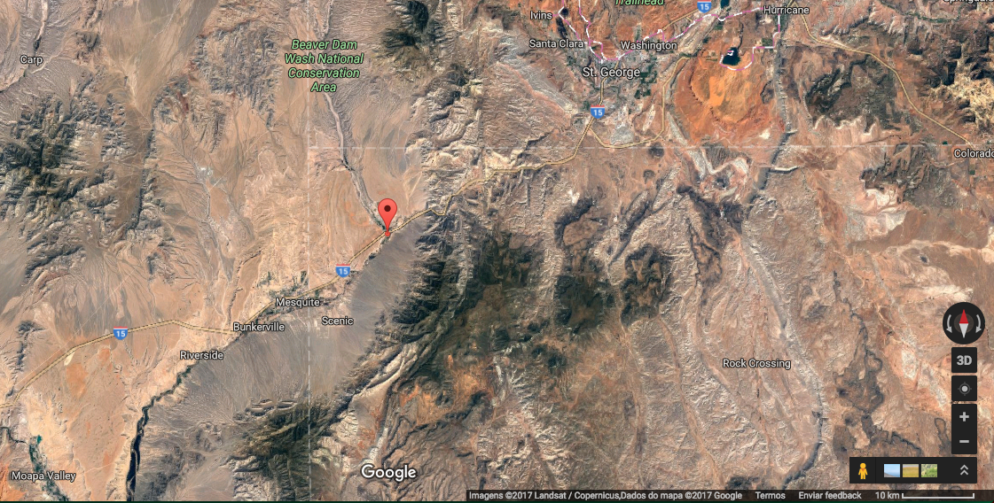
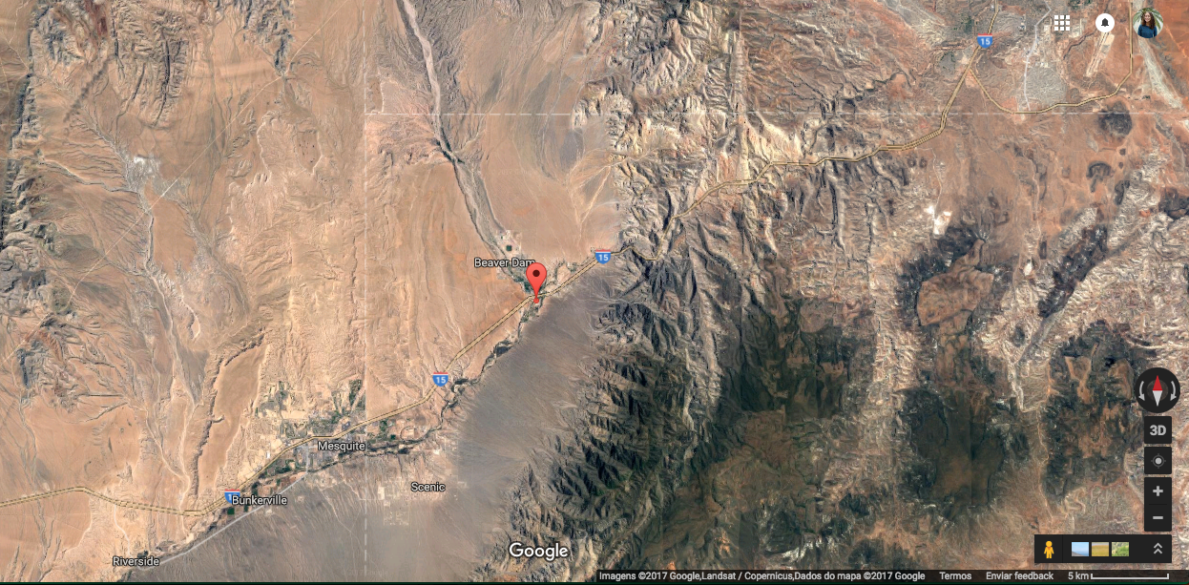
Outliers
10 out of 5053 observations (3 sites)
TP = 4.68 to 24 mg/L
Not biologically possible
Unless town, treatment plant
Google map; satellite
Typo

Slide 6
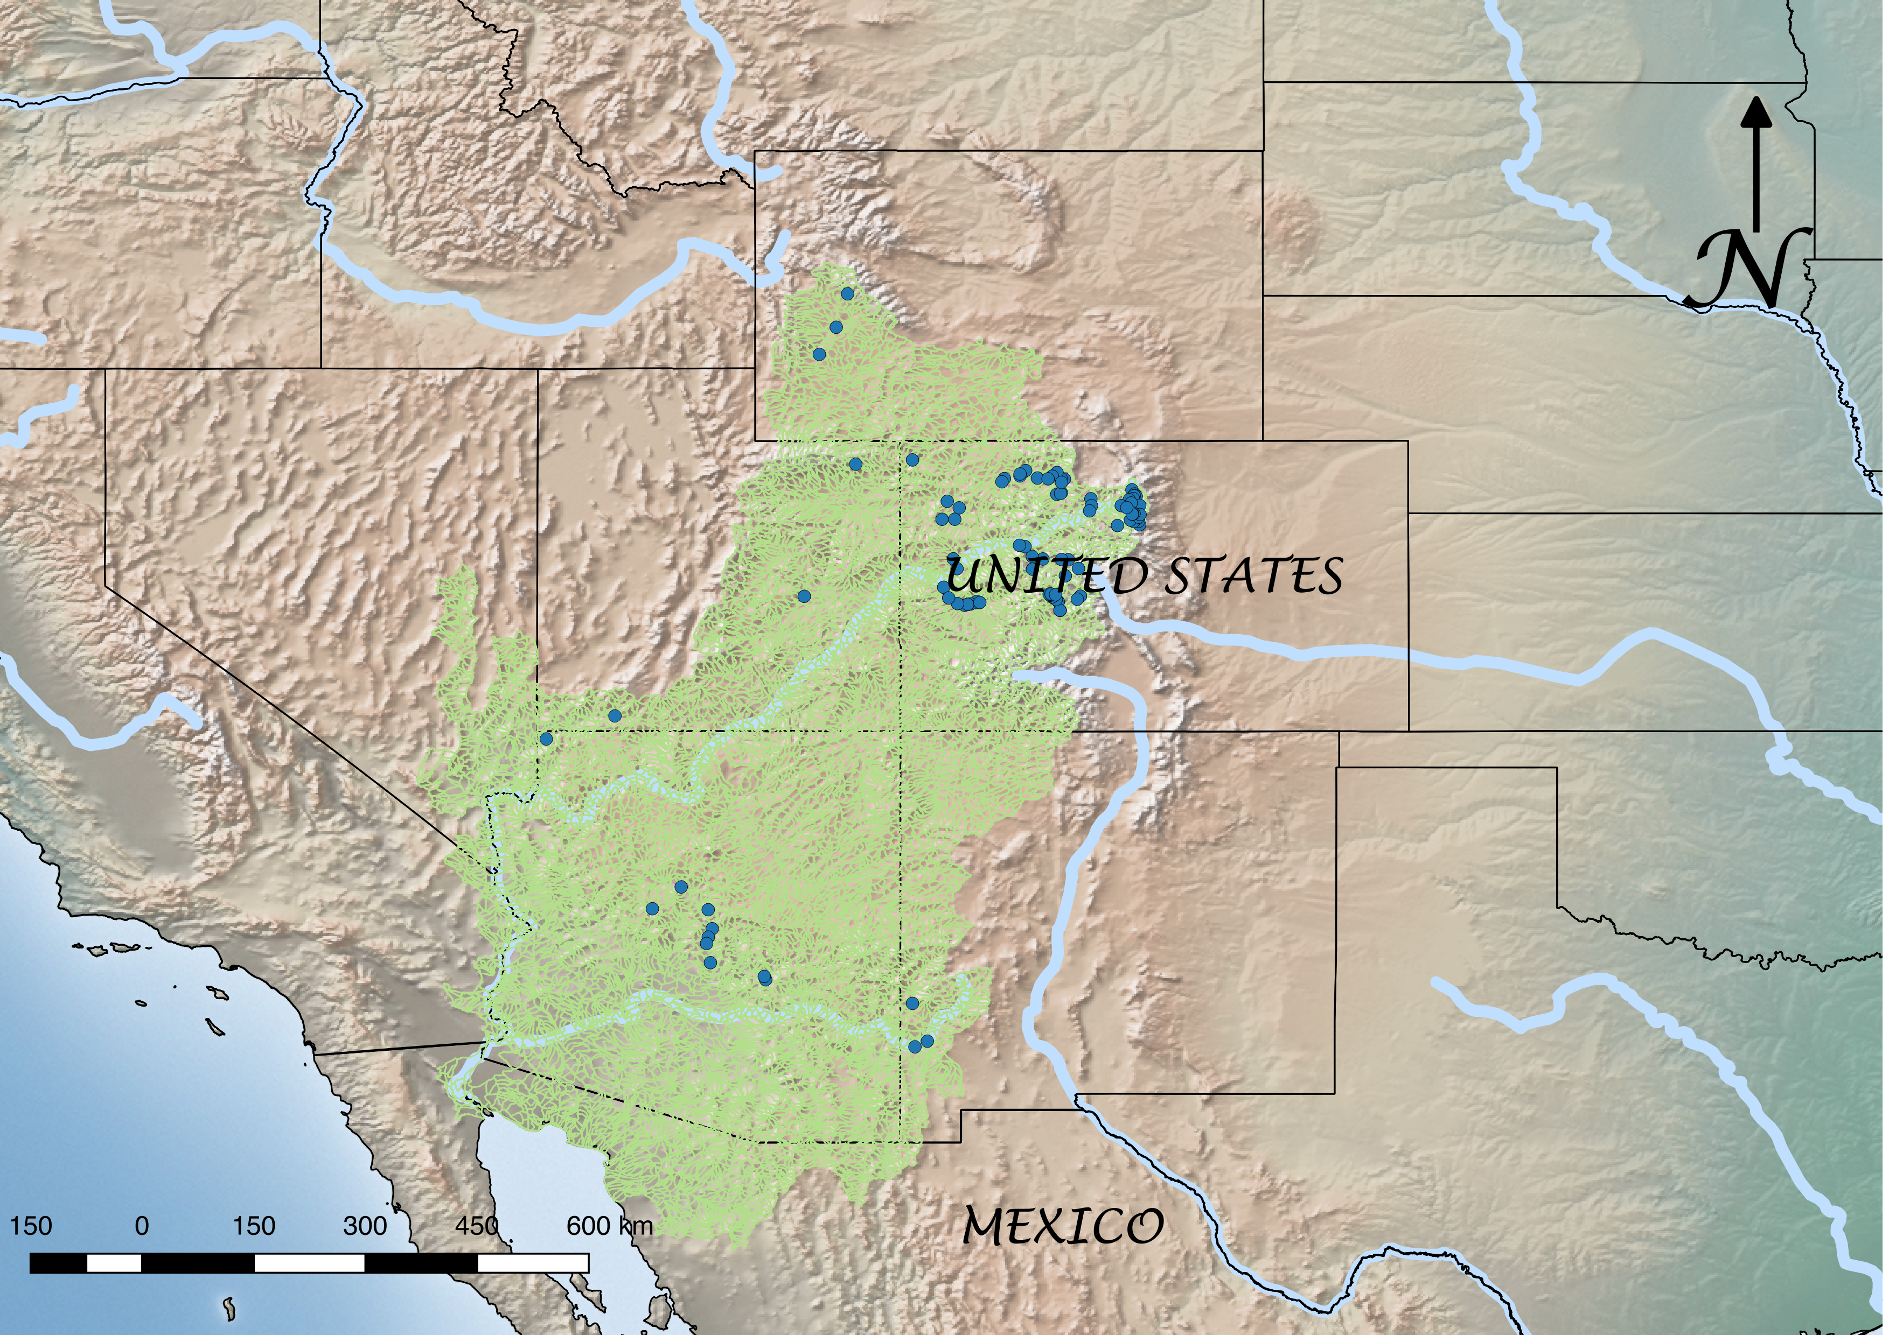
Notes:
93 sites in the Colorado river watershed

Slide 7
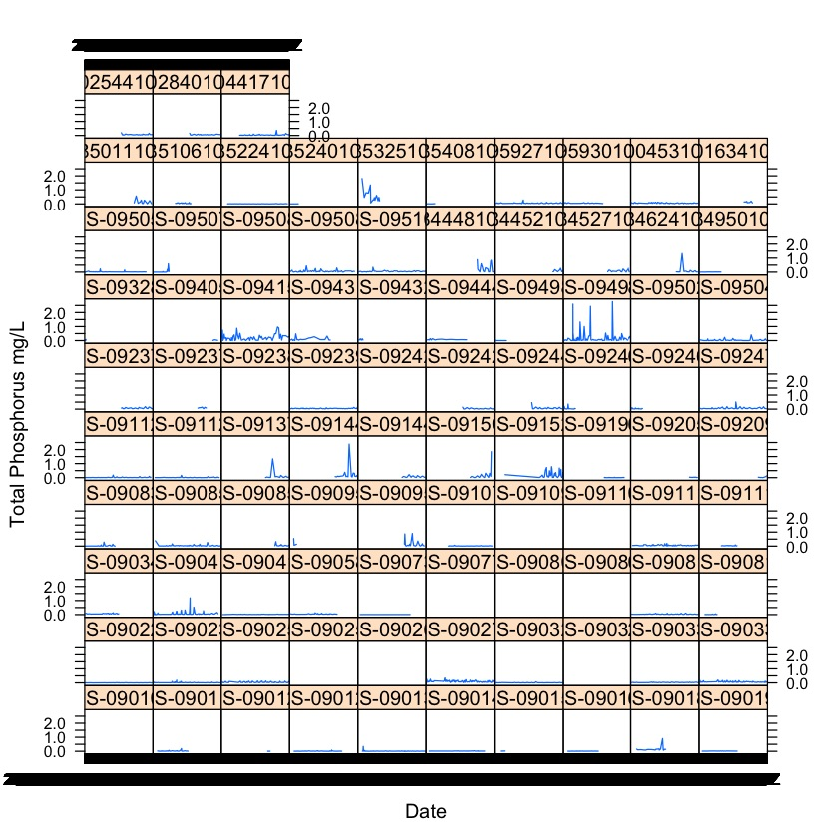
Notes:
Since we have different points from different months of the year, we wanted to check for any seasonal variability in the dataset.
We didn’t find visually any temporal variability and by this we can infer that if we find a variation depending on streams, then it’s really either the streams or the land use having an effect, and not the season.

Slide 8
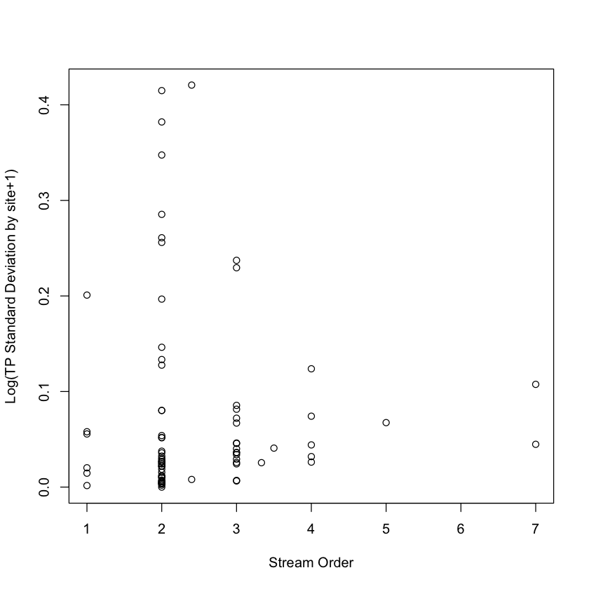
TP variability (log SD +1 by site) vs Stream Order
Notes:
Regression, no significant relationship.
Interesting funneling.
STD by site.

Slide 9
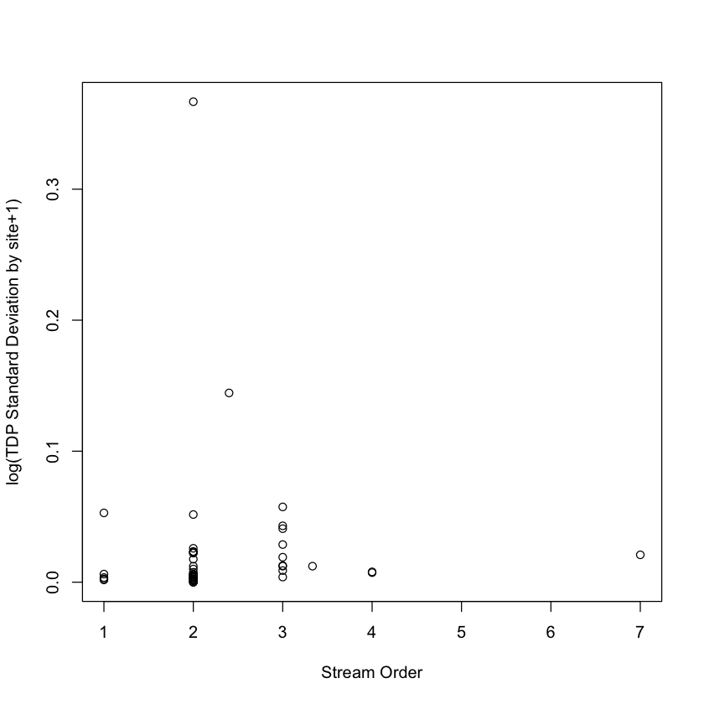
TDP variability (log SD + 1 by site) vs Stream Order

Slide 10
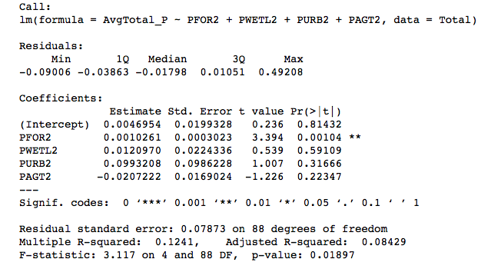
Total P, multiple linear regression

Slide 11
Notes:
Multiple linear regression to see how well the different land use types explained TP. This time with

Slide 13
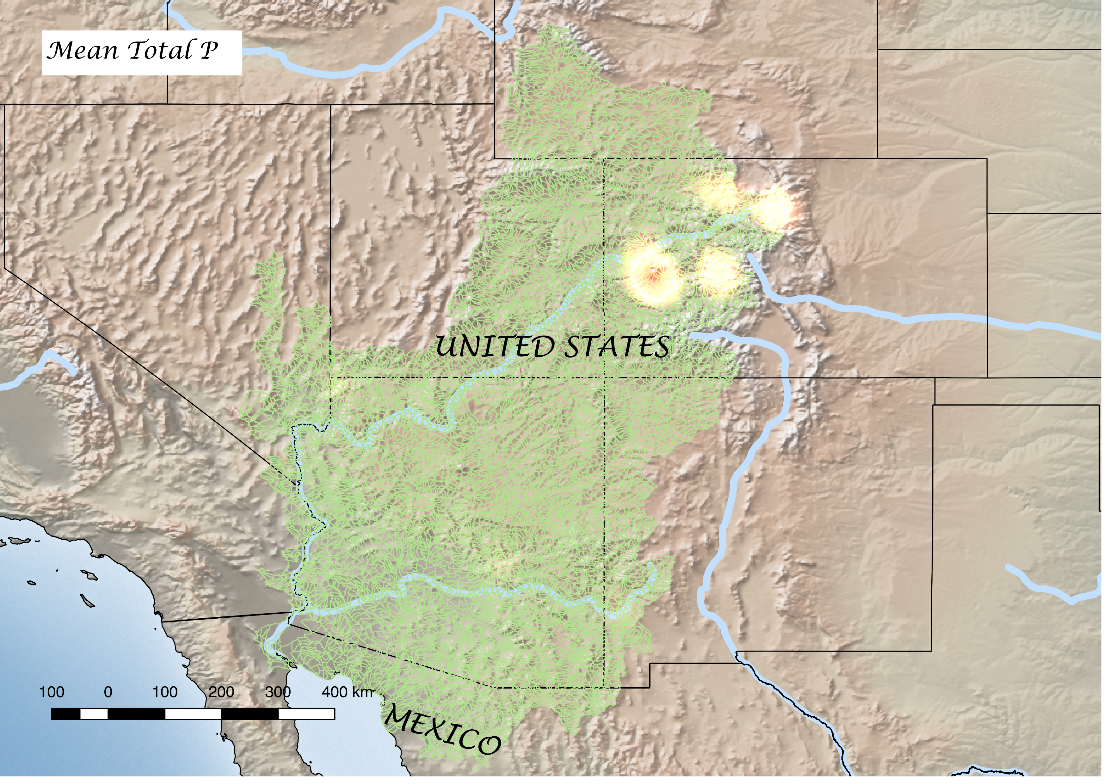
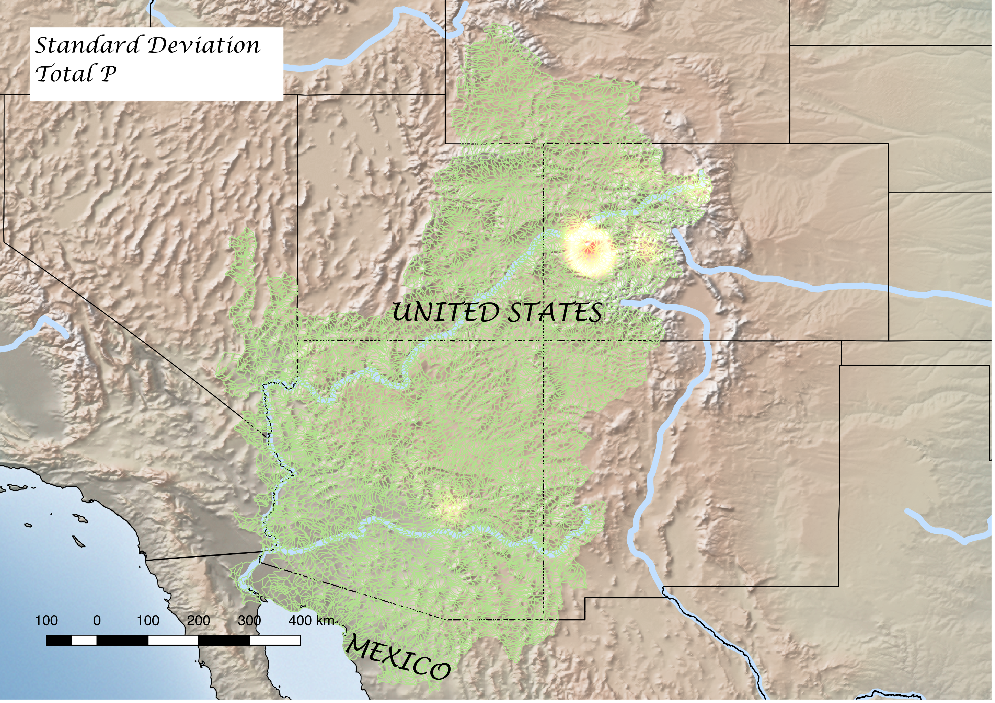
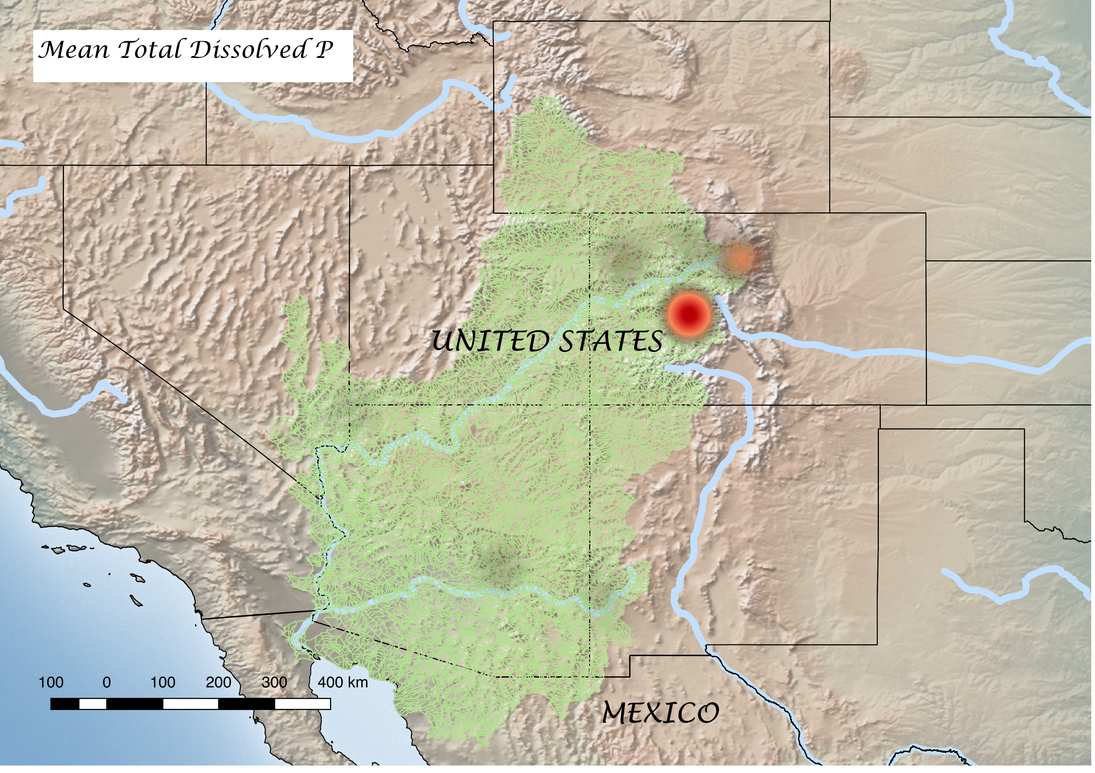
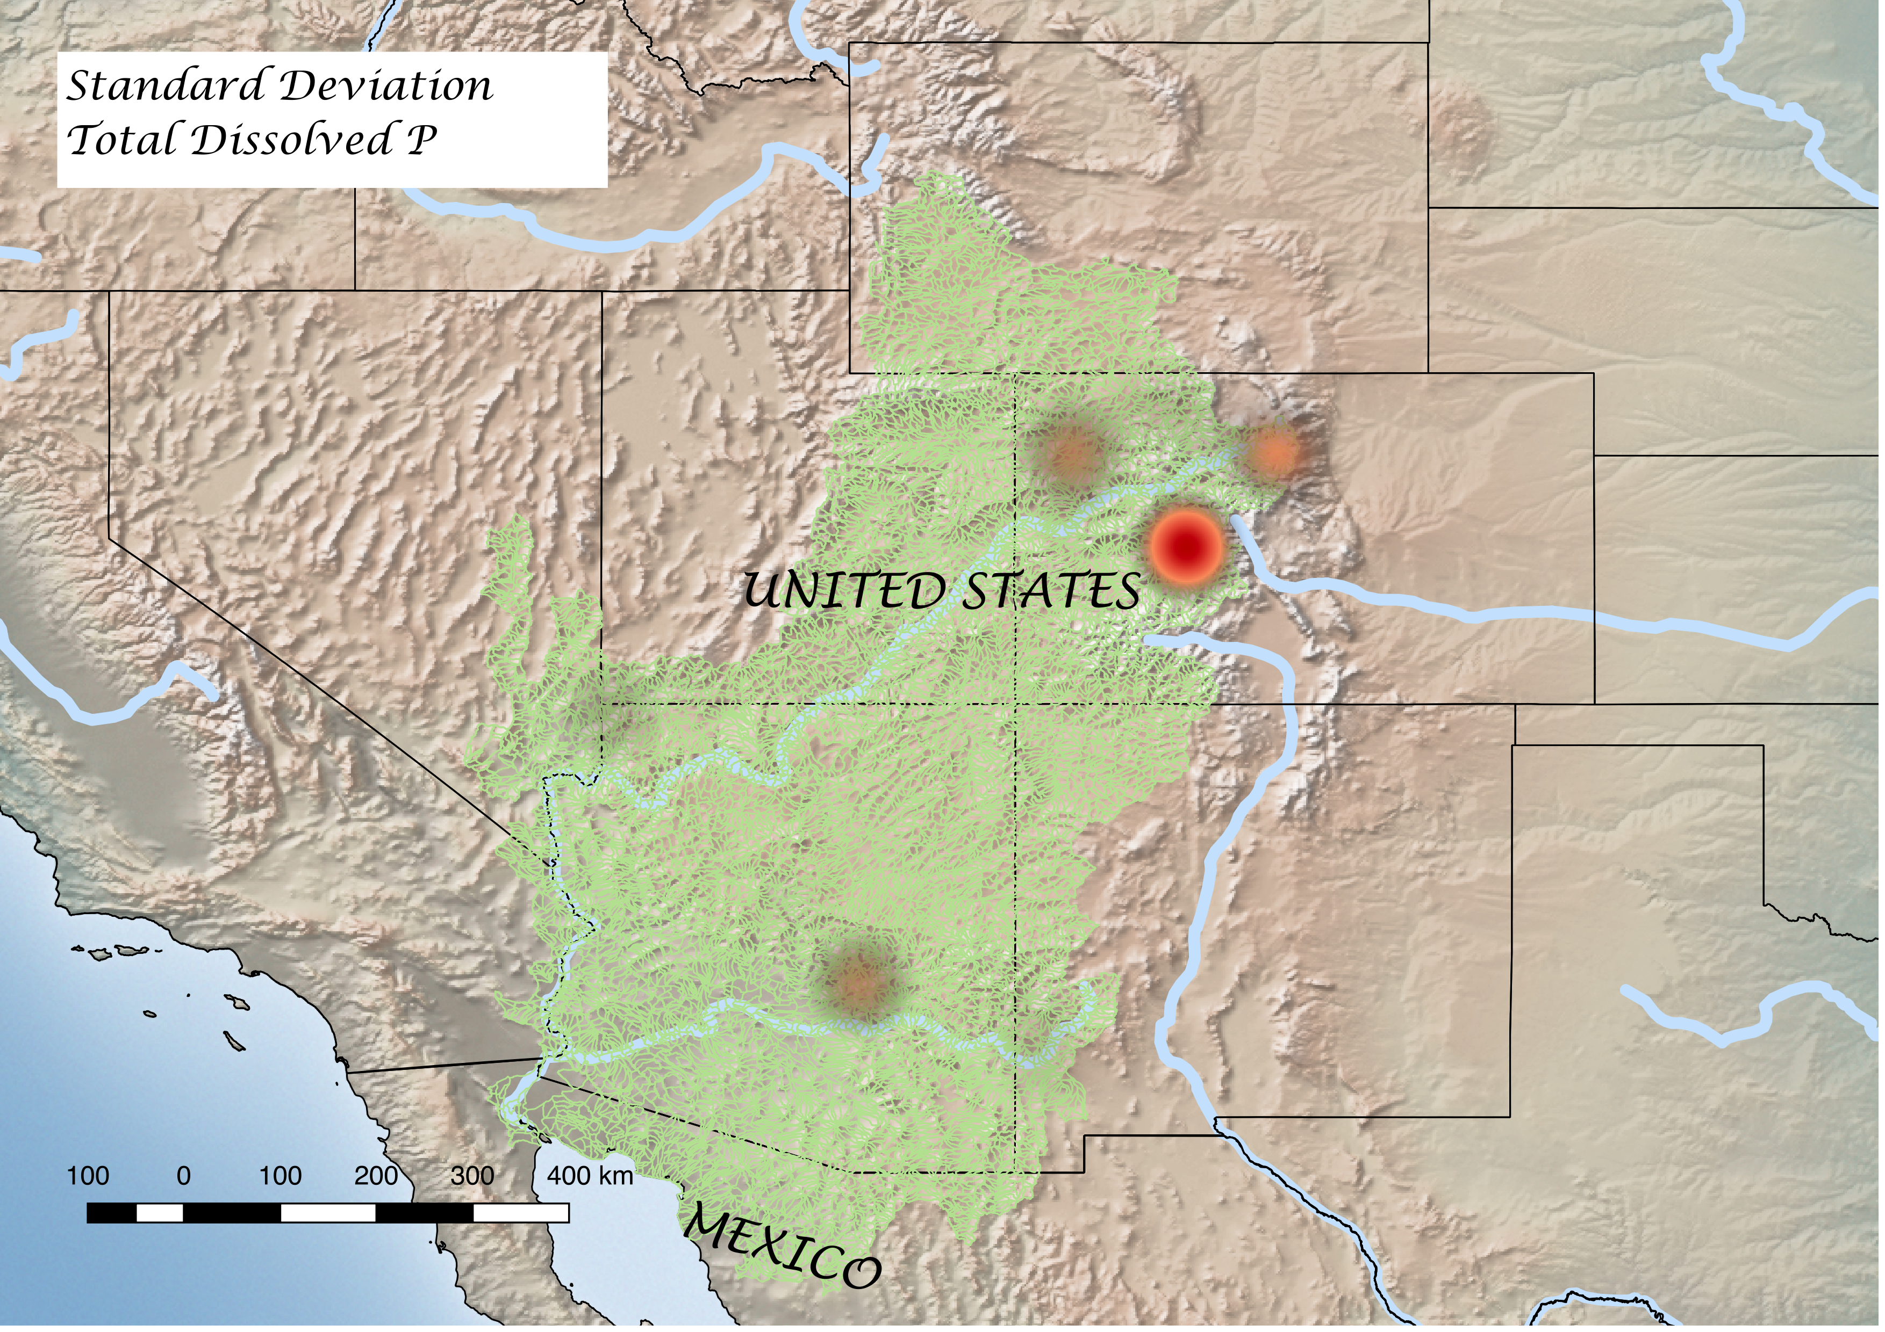
Notes:
Hot spot of P, makes sense bc near Rockies
Created using heat-map plugin in Qgis which both takes into account the density of points and the values of variables associated with those points.
Not a heat map for the whole watershed, just for a concentrated amount of points.
Hotter colours = hotter values

Slide 15
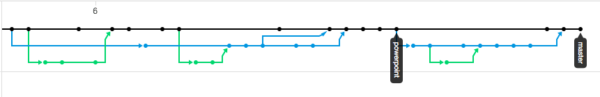
GitHub

Slide 17
Zero Answers, Infinite Questions
Spatial overlap between total phosphorus hotspots + forest cover + Rocky Mountains – possible erosion from mountains?
Stream order not correlated with P variability – is stream order the right metric?

Slide 18
Lessons Learned
Working in terminal is a learning curve.
Many contributors in a GitHub repository – how to have good hygiene?
Need a clear data workflow from start
Understand the dataset before you begin analysis
Take more time in discovery phase
Do research slowly – CALM DOWN.
Jupyter Notebook was nice for coding together.
SQLlite is lit AF.

Slide 19
THANK YOU!!

